Slide 1

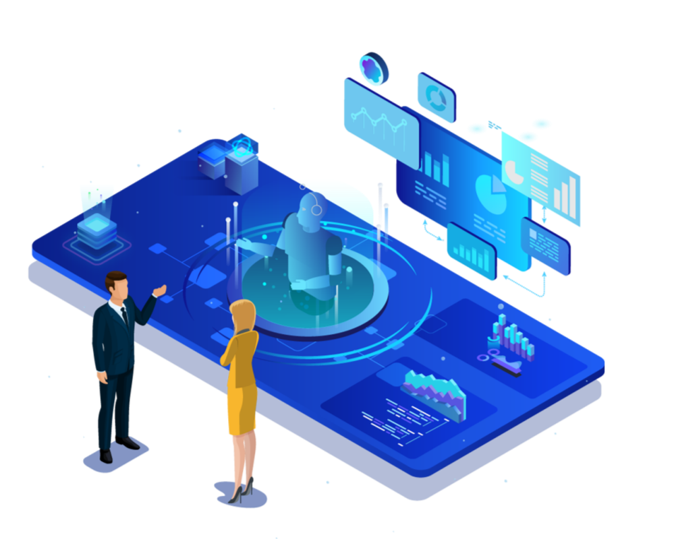

Let people learn blockchain easily

Slide 2

CONTENTS
Project Introduction
Pain Points
Project Features
Roadmap
Team Introduction
Our Users
Tokenomics
Financing Instructions

Slide 3


Project Introduction
Cicada is a decentralized encyclopedic knowledge base and content distribution protocol, equivalent to WEB3's Wikipedia. It is empowered by the powerful economic system of the blockchain, so that both users and contributors can benefit from it. Why is it called cicada?
1. Cicada, also known as "Zhi Liao" in China, has the meaning of knowing, which fits the theme of the project very well
2. Cicadas hatch according to the prime number of years, the magical natural evolution law, in line with the scientific development orientation of the project
3. Cicadas can burst out fierce and tenacious vitality from birth, which indicates that the project will have great development momentum.

Slide 4
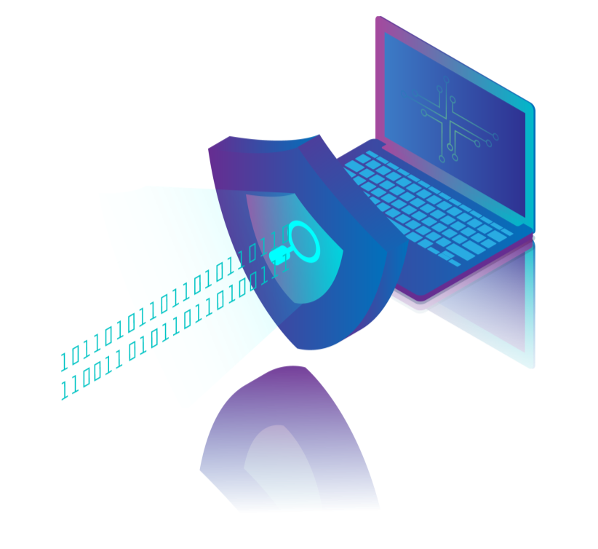
Project Introduction
What goals will be achieved?
Fully community-based, rejecting the officialization of project information, binding more common interests, and generating a strong consensus.
Allow users to obtain valuable and systematic content in a timely manner.
Allow participants to have the right to benefit distribution, governance and supervision.

Slide 5
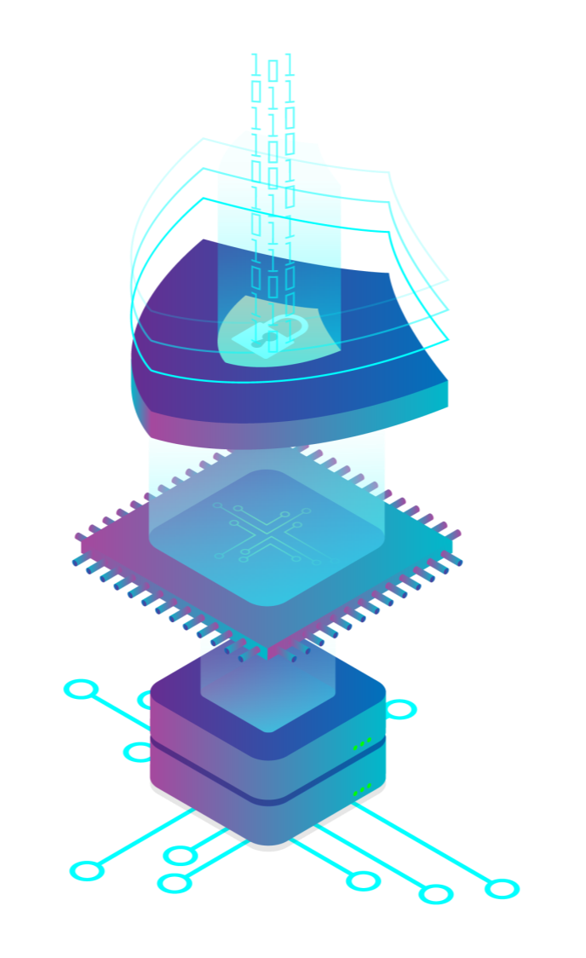
Team Introduction
There are 7 team members, two are graduate students, and the rest are undergraduate graduates! The core members of the team have 1-3 years of experience in blockchain development, all of them have transformed from the traditional Internet to the blockchain direction, and have deep programming accumulation! At present, an Ethereum-based wallet system has been developed for the NFT minting transaction system in intellectual property,DAPP such as decentralized voting system.

Slide 6
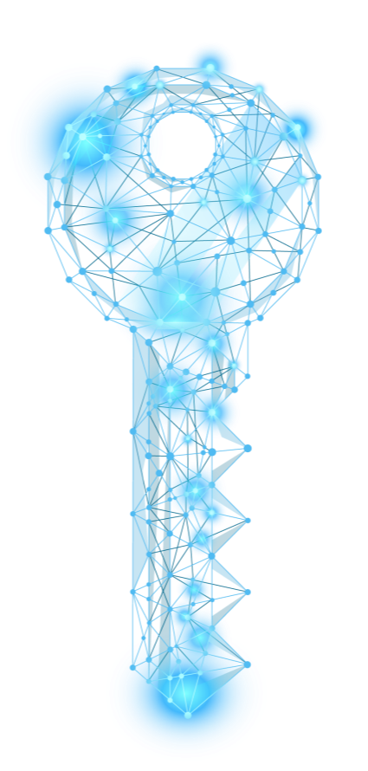
Pain Points
In the traditional platform, there is a contradiction in the distribution of interests between the platform owner and the contributors to the core value of the platform.
Governance contradictions between platform owners and platform core value contributors in traditional platforms.
Taking the blockchain project as the entry point, the blockchain project information has problems such as scattered, inaccurate, untimely, and inconvenient search.

Slide 7

Our Users
Industry experts, senior industry participants, industry enthusiasts, well-informed people, and industry investors.
Take the blockchain as an example: project builder, blockchain enthusiasts, investors in the currency circle.

Slide 8
Project Features
2
4
1
3
5
Based on the economic system, with the blockchain project as the entry point, gradually develop into an encyclopedic knowledge base
Use soul tokens to establish a user growth system and credit system
Use economic incentives to solve the problems of data collection and user content contribution
Use on-chain governance and rewards to solve data quality problems

Slide 9
Tokenomics
Two types of tokens are issued: a transferable native token and a non-transferable soul-bound token
Native tokens are used to incentivize point and content donors
The soul-bound token recording system and the donation and disposal of donors are used to establish a credit evaluation system, thereby affecting the positive proportion of internal donors

Slide 10

行业PPT模板http://www.1ppt.com/hangye/
Roadmap
Audit report
Officially launched
Project development-distribution system
Project Design
Project Development - Content System
Test chain online
Project development-incentive system
Project development-governance system
Demand Analysis
2024Q2
2024Q1
2023Q4
2023Q3
2022Q4
2023Q2
2023Q1

Slide 11
Financing Instructions
Function optimization iteration
Operation and promotion of products
Audit of code
Enrich technical strength

